Slide 1
Machine Learning
ACM at UGA

Slide 2
AI/Machine Learning resources at UGA
Institute for Artificial Intelligence https://www.ai.uga.edu/
interdepartmental research and instructional unit within the Franklin College of Arts and Sciences
2 degree programs:
BA in Cognitive Science
MS in Artificial Intelligence
Deep Learning @ UGA https://delug.github.io/index.html
An interest group of UGA students and faculty discussing deep learning
Data Dawgs https://datadawgs.github.io/
An Informatics organization at the UGA College of Engineering.
Focused on Data Science with minor emphasis in Machine Learning and Deep Learning

Slide 3
Courses at UGA related to Machine Learning/AI
CSCI 3360 - Data Science 1
CSCI 4330/6330 - AI and the web
CSCI 4360/6360 - Data Science 2
CSCI 4380/6380 - Data Mining
CSCI (ARTI) 4540/6540 - Symbolic Programming
CSCI (ARTI) 4550/6550 - Artificial Intelligence
CSCI 4560/6560 - Evolutionary Computation
All CSCI courses: http://bulletin.uga.edu/CoursesHome.aspx?Prefix=csci

Slide 4
What is Machine Learning?
Programming computers so they can learn from data.
Intersection of Computer Science, Applied Math, and Statistics
“Machine Learning is the field of study that gives computers the ability to learn without being explicitly programmed” - Arthur Samuel, 1959
Examples:
A spam filter can be trained to classify emails as spam or not-spam (‘ham’) by looking at examples of emails that have already been labeled.
A biologist might train a model to classify species of plant based on data gathered in the field. E.g. petal width, bean count, etc.
A real estate firm uses a ML algorithm to estimate the value of a house given various attributes (bedrooms, year built, location, etc)

Slide 5
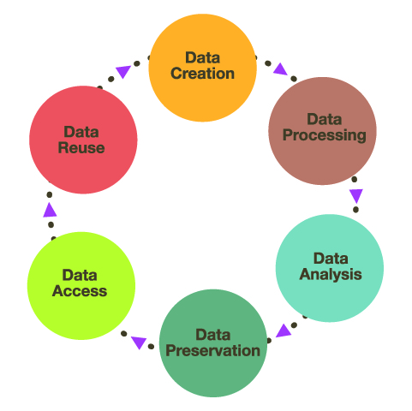
Are Data Science, ML, AI the same thing?
Data Science is concerned with the entire Data Life Cycle
Machine Learning is primarily used in the processing and analysis stages
AI is more difficult to pin down. Loosely defined as “Intelligent behavior exhibited by machines.” What we consider to be “intelligent” changes over time
Deep Learning is a subset of ML concerned with deep neural networks
Data Mining is the process of extracting a small amount of useful information from large sets of data.

Slide 6
Anatomy of a Machine Learning problem
We’re given a dataset with several instances (rows) and features (columns). One of these features is our target. We separate this column out from the rest. Our model (algorithm) is a function that takes the non-target features as input, and outputs a predicted target value. The target may be a class (‘spam’ or ‘not spam’) or a numeric value (predicted value of a house, for e.g.).
Once we have our data, we can train the model. Training is an optimization problem. At each step, we measure the performance of our model, and tweak it to be slightly better. In general, we’ll be minimizing a Cost Function or maximizing a Utility Function. We’ll talk more in depth about training algorithms soon.

Slide 7
What kinds of problems do we use ML for?
Problems which require a lot of hand-tuning or a long set of rules.
Complex or difficult problems for which there is no good existing solution using traditional techniques (e.g. image recognition)
Fluctuating Environment - ML systems can adapt to new data
Gaining insight about complex problems or huge datasets (e.g. data visualization techniques)

Slide 8
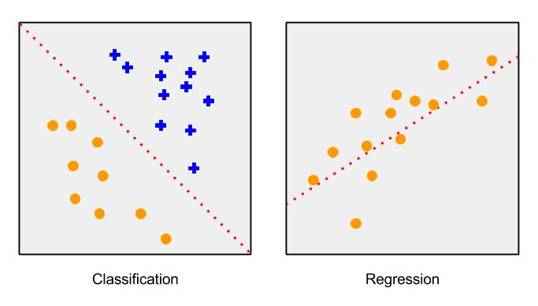
Types of Machine Learning Systems
Supervised
Data has labels (target feature)
Classification, Regression tasks
Unsupervised
Data has no labels
Clustering, Visualization tasks
Reinforcement
Instead of an algorithm and data, we have an Agent and an Environment.
The agent can observe the environment, select and perform actions, and get rewards or penalties as a result of the actions.
Over time, the agent learns the best Policy (list of actions) to maximize the reward.

Slide 9
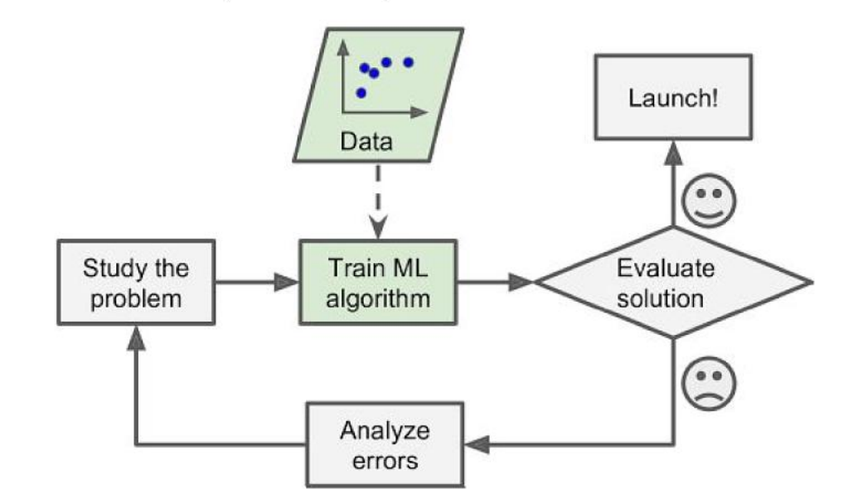
Machine Learning project flow
Batch Learning:
We train our system using all available data. This can be very time- and resource-intensive for big datasets. Once the system is launched, it’s done learning.

Slide 10
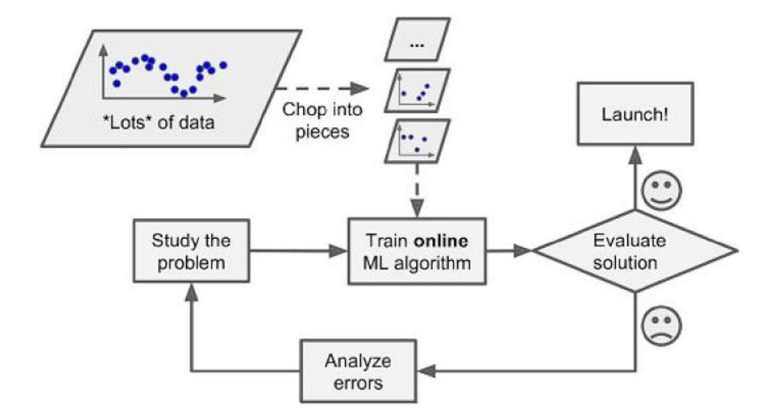
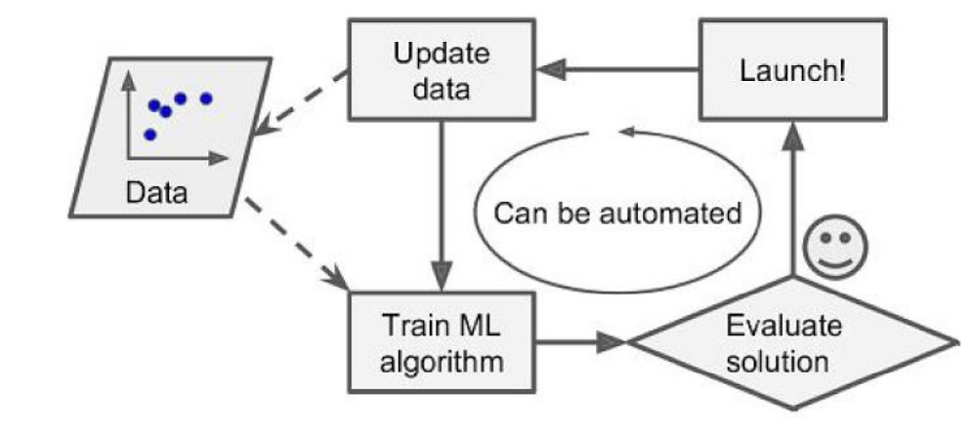
Online Learning
Train model incrementally, using mini-batches. We can continue training our model throughout the project’s (product’s) lifespan. This is also useful for offline training when using a huge dataset. Each training step is fast and cheap!

Slide 11
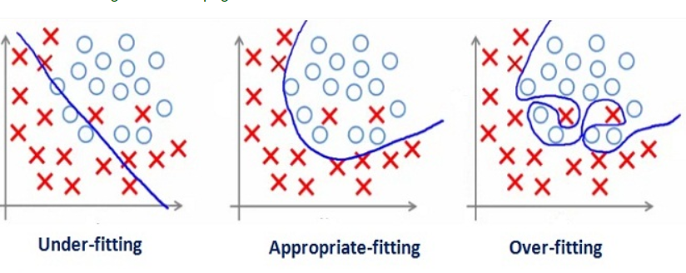
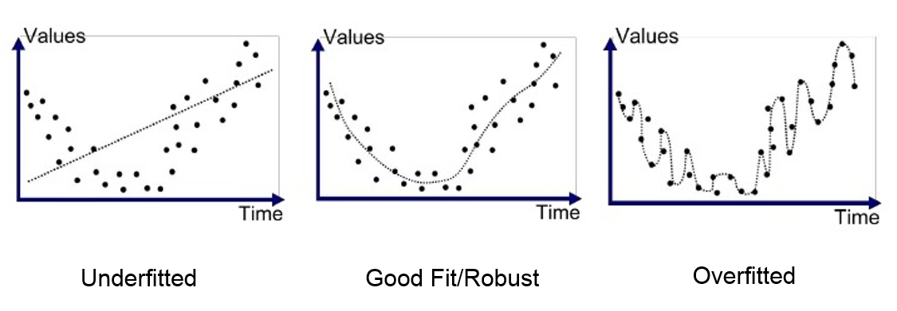
Challenges and Pitfalls of Machine Learning
Two Main Categories:
Bad Data
Insufficient quantity
Non-representative data
Poor Quality
Irrelevant Features
Bad Algorithm
Underfitting/Overfitting
Mismatched model to dataset
Certain models are well suited to certain tasks. There is no ‘universal’ ML algorithm

Slide 12
Free Sources of ML Data
Kaggle https://www.kaggle.com/ - Online community for collaboration and competition among data scientists.
UCI Machine Learning Repository https://archive.ics.uci.edu/ml/index.php - great resource for datasets
Facebook Graph API https://developers.facebook.com/docs/graph-api/
International Monetary Fund (IMF) https://www.imf.org/en/Data
OECD https://stats.oecd.org/
More datasets here: https://en.wikipedia.org/wiki/List_of_datasets_for_machine_learning_research

Slide 13
Software Packages We Will Use
Python 3.6, as provided by the Anaconda distribution https://www.anaconda.com/download/
Additional Python Libraries:
Scikit-learn https://scikit-learn.org/stable/
NumPy http://www.numpy.org/
Pands https://pandas.pydata.org/
Matplotlib https://matplotlib.org/
TensorFlow https://www.tensorflow.org/
IDE
Jupyter https://jupyter.org/

Slide 14
Possible Projects in Machine Learning:
What sounds interesting?
Predicting Stock Market Prices
Classifying Images
Annotating Images
Movie Recommendation System
Classifying Tweets
Voice Recognition
Classifying Text Documents
Medical Diagnostics
Train a RL agent to play a video game

